Slide 2
A Loving People
A Righteous People
A Unified People
An Obedient People
A Growing People
A Prayerful People
A Sharing People
A Pure People
A Looking People

Slide 3
A Looking People
Philippians 3:20
For our citizenship is in heaven, from which also we eagerly wait for a Savior, the Lord Jesus Christ

Slide 4
A Looking People
1 John 4:17
By this, love is perfected with us, so that we may have confidence in the day of judgment; because as He is, so also are we in this world.

Slide 5
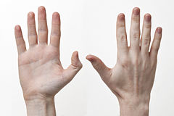
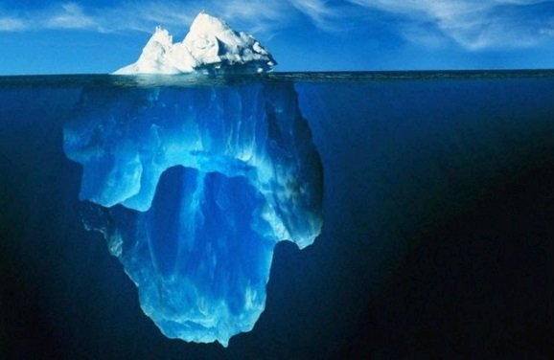
Attention
Action
Attitude

Slide 6
Attention
A Looking People
1 Thessalonians 4:13
But we do not want you to be uninformed, brethren, about those who are asleep, so that you will not grieve as do the rest who have no hope.

Slide 7
Action
A Looking People
1. The first leg of any journey is deciding to go
2. Read the travel brochure
3. Convince loved one to join us

Slide 8
Action
A Looking People
Galatians 6:1
Brethren, even if anyone is caught in any trespass, you who are spiritual, restore such a one in a spirit of gentleness; each one looking to yourself, so that you too will not be tempted.

Slide 9
Action
A Looking People
1. The first leg of any journey is deciding to go
2. Read the travel brochure
3. Convince loved one to join us
4. Decide what to "pack"
5. Make final preparations

Slide 10
Attitude
A Looking People
1 Peter 1:5
who are protected by the power of God through faith for a salvation ready to be revealed in the last time.

